Slide 1

TRY IT OUT
SKIP THE CHANGING ROOM
Notes:
1

Slide 2
Overall Structure of the Website
Front end
Several interlinked HTML documents, styled with CSS
Javascript was used to implement extra features
Back end
Php scripts, takes and returns data from the web pages allowing SQL queries to be executed
Database

Slide 3
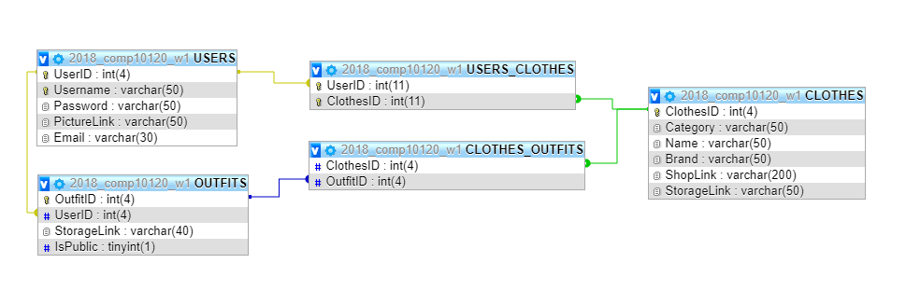
Structure of the Database

Slide 4
Design and Layout
Used bootstrap for overall layout
W3Schools for specific features

Slide 5
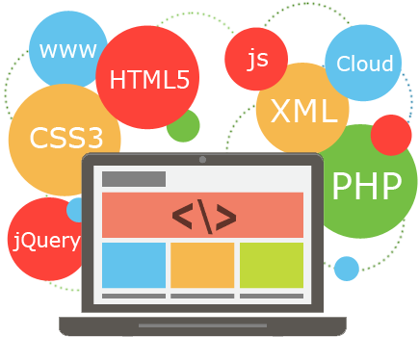
CREATING THE WEBSITE
JAVASCRIPT / JSON
Extra features where html was not enough
SERVER SIDE PHP SCRIPTS
For transferring data to and from
the front end of the website
mySQL
Database management system used to store data

Slide 6
MD5 HASHING PASSWORD
Used the MD5 hashing algorithm to store the registered passwords in the database so it is not sent over the network as plain text making it more secure.
Log-In sends the hashed password to compare the one stored in the database, no decoding occurs.

Slide 7
Validations
General Validations
Checks if any fields are empty.
EMail Validations
Checks if it is a valid email via a standard PHP API command, (Checks if there is an ‘@’ character and ends in ‘.com’).
Checks if email already exists in the database.
Username Validations
Checks if username already exists in the database.

Slide 8


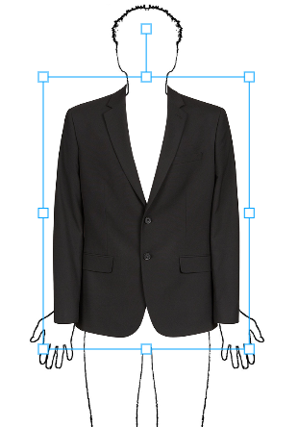

CREATING THE WEBSITE
Konva Class
JQuery

Slide 9
CREATING THE WEBSITE
GitLab

Slide 10

ORGANIZATION
SPLIT THE TASKS
INTERNAL DEADLINES
REGULAR GROUP MEETINGS
Notes:
10

Slide 11
ORGANIZATION
DESIGN, WEBPAGE IMPLEMENTATION, TERMS AND CONDITIONS – SANA, GLORIA
DATABASE, SERVER SIDE SCRIPTING, DYNAMIC PAGE CREATION – ARRON, NIKOLAY
DRAG AND DROP, STORING PICTURES, PAGE FOR EVERY OUTFIT - DOMINYKAS, MARIOS

Slide 12
Ethical and Professional Consideration
Consent from the Fashion Retail Companies
Terms and conditions
Privacy-
We would no save the base image the user uploaded
Security
All the passwords are stored in the database with hash encoded
Notes:
If the user has experienced any issue with our website, want to report an outfit in the Explore page, or any other enquiry, they can contact us using the email address in the Contact Us page and we aim to respond to them within two days

Slide 13
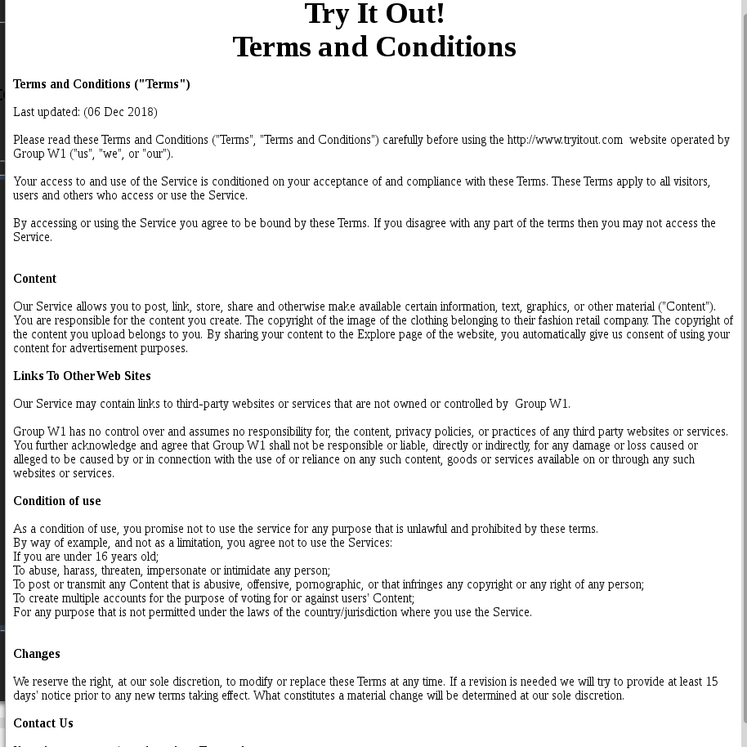

Slide 14
THANK YOU FOR LISTENING

Slide 15
ANY QUESTIONS?

Slide 16
Presenting WebSite
Overall structure of system – Arron
Structure of database – Nikolay
What tools have been used – All
-HTML / CSS / Bootstrap – Sana and Gloria
-JavaScript / PHP / Json / MySQL – Arron
-MD5 Hashing algorithm to protect passwords – Marios
-Validations Email / Passwords – Marios
-Encoding images as strings to pass to server storage - Dominykas
-Ajax - Dominykas
-Konva class - Dominykas
-GitLab – Sana V Gloria
Organisation
-Decisions made every Monday during Group Meetings - Dominykas
-Work Partition: At first teams of two then mixed - Dominykas
-Work Integration: GitLab – Each had own subdirectory for our own content then merged in a single directory – Marios
-Ethical Issues: Save only edited picture, Terms & Conditions must be accepted when signing up, Got permission from the Brands – Gloria
Improvements – Nikolay & Marios
-Rate outfit, Report Outfit, Filter/Search content, More brands
-Research tools used more, before implementing them
-Bootstrap usage from start to save time than using HTML and CSS, WebPage footer
-Knowing Git better would have helped save time as sometimes commits and pushes did not execute successful
-Slowed down progress in the middle (during and after xmas) – Should have applied strict deadlines but in the end it worked out :) :D.
Managed to complete work a day or two late. Got help from each other.

Slide 17
Work Integration - GitLab
Beginning, each had independent work so we each had our own subdirectory inside a root directory in GitLab.
As we progressed we began working in each others subdirectories
Finally we merged all subdirectories into one with all working versions of scripts etc.

Slide 18
Work Integration - GitLab
Beginning, each had independent work so we each had our own subdirectory inside a root directory in GitLab.
As we progressed we began working in each others subdirectories
Finally we merged all subdirectories into one with all working versions of scripts etc.

Slide 19
Extra Website Functionality
Rate/Report outfit
Filter/Search content
More brands

Slide 20
Improvements on research
More research before implementation
Using bootstrap from an earlier stage

